Slide 1
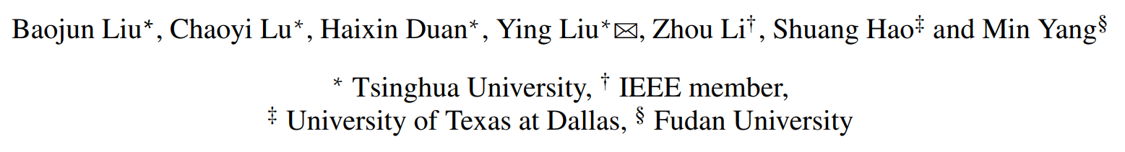
Who Is Answering My Queries: Understanding and Characterizing Interception of the DNS Resolution Path
USENIX 2018

Slide 2
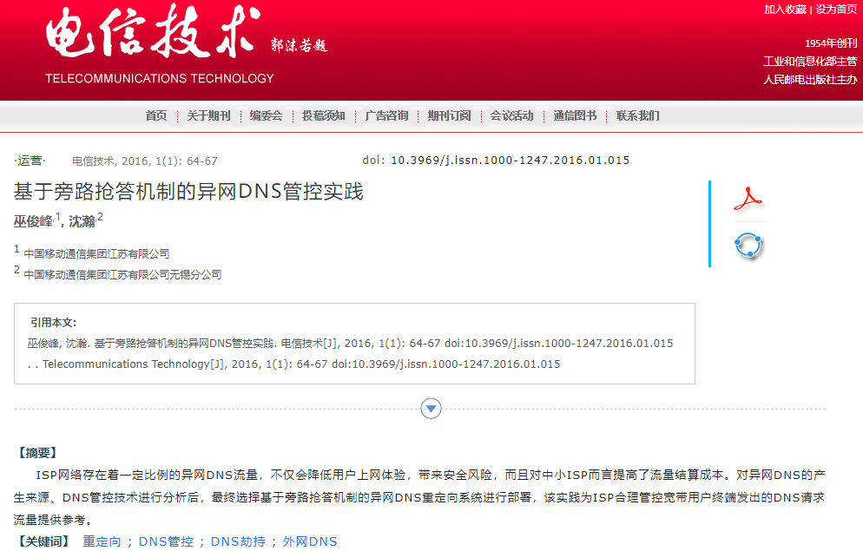

Slide 3
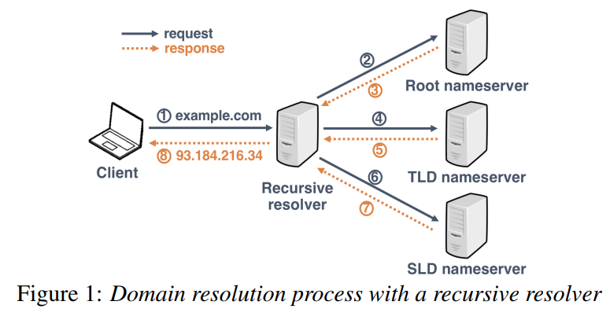
Background: Domain resolution

Slide 4
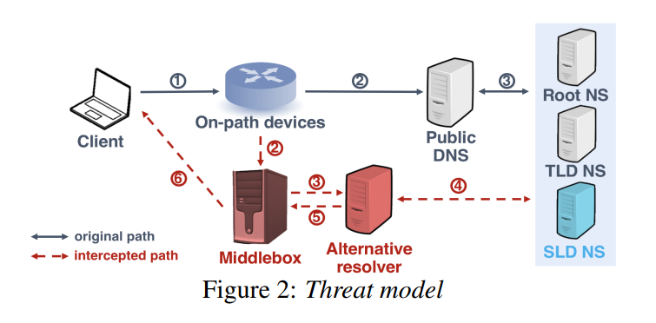
Threat Model

Slide 5
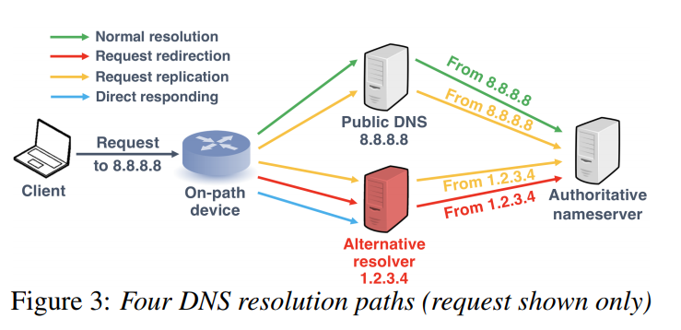
Threat Model

Slide 6
Challenge: large-scale measurement
Acquire numerous clients belonging to different Autonomous Systems (ASes)
Verify whether intercepted – difficult to sense from clients

Slide 7
Methodology
Send DNS request about controlled domain to public resolver A
Record request (from resolver B) at our authoritative server
Compare A with B; Validate response
Point: alternative resolvers need to reach authoritative nameservers

Slide 8
Design
Send DNS request about controlled domain to public resolver A
Different query domain to avoid caching: UUID
Know which public DNS resolver client send to: include to domain, e.g. UUID.Google.OurDomain.TLD
Diversified DNS requests:
UDP/TCP
A/AAAA/CNAME/MX/NS
Choose public resolvers: using Alexa top ranking: Google, OpenDNS, Dynamic DNS, Tsinghua EDU DNS

Slide 9
Design
Compare A with B; Validate response
Anycast address (e.g. 8.8.8.8) merely match unicast addresses (e.g. 74.125.41.0/24): use PTR and SOA records
Response = hash(timestamp, src IP, requested domain name) -> last32bits

Slide 10
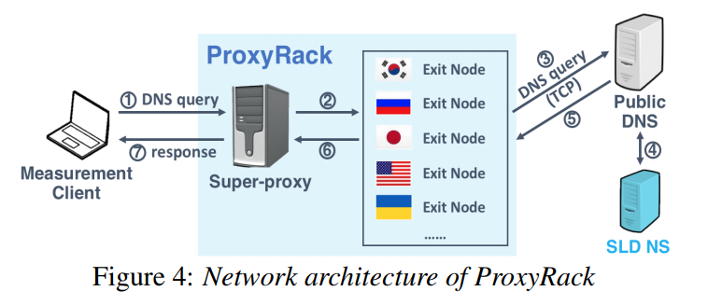
Methodology: Vantage Points
Global analysis – ProxyRack
SOCKS Proxy, request send to any specified resolver over TCP

Slide 11
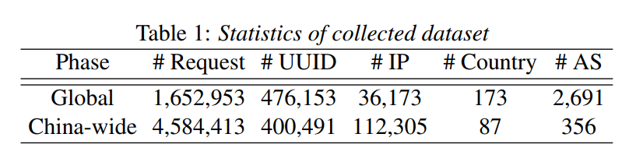
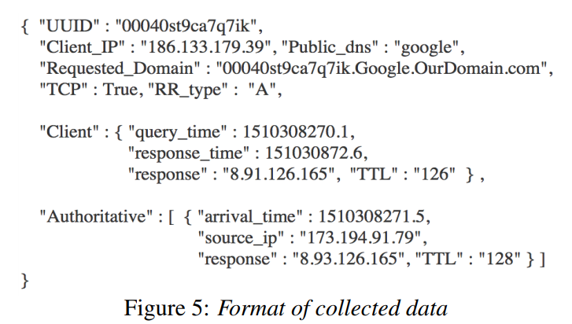
Dataset

Slide 12
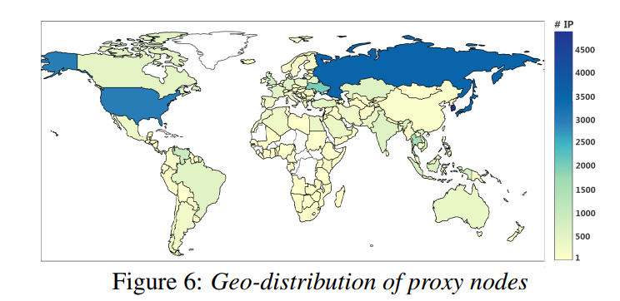
Dataset: Geo-distribution
Top: Korea, Russia, Japan and the US

Slide 13
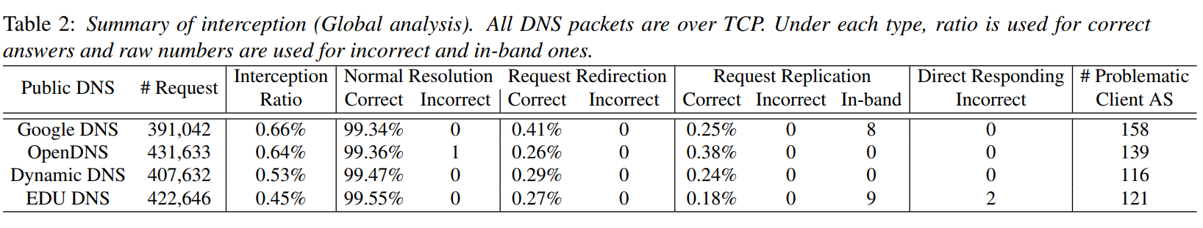
TCP DNS Interception Analysis (Global)
198 (out of 2,691, 7.36%) client ASes witness intercepted traffic
DNS traffic sent to renowned public DNS services are more likely to become victims of DNS Intercept

Slide 14
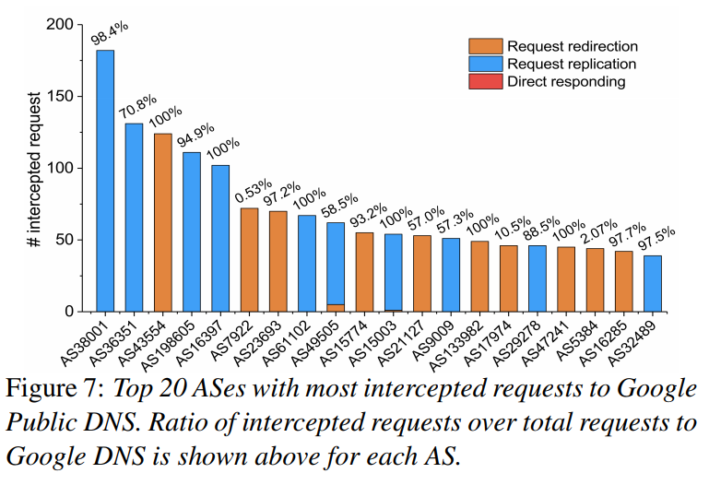
Analysis (Global) : AS-Level Characteristics
Types and ratio: unified policy of DNS traffic filtering within an AS

Slide 15
Analysis (Global) : AS-Level Characteristics
Country-level analysis: 158 ASes, span 41 countries
Russia 44 ASes (28%), US 15 (9%), Indonesia, Brazil and India

Slide 16
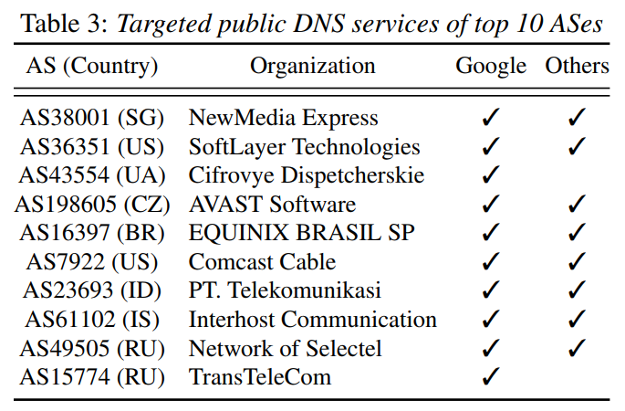
Analysis (Global) : AS-Level Characteristics
Targeted public DNS services

Slide 17
Analysis (Global) : AS-Level Characteristics
Country-level analysis: 158 ASes, span 41 countries
Russia 44 ASes (28%), US 15 (9%), Indonesia, Brazil and India
Targeted public DNS services
2 ASes (AS43554 and AS15774) exclusively intercept traffic to Google DNS

Slide 18
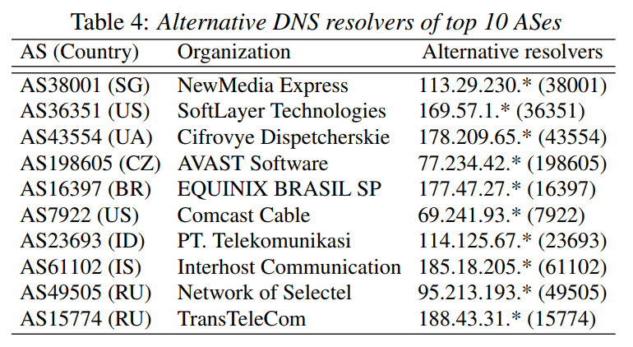
Analysis (Global) : AS-Level Characteristics
Alternative resolvers

Slide 19
Analysis (Global) : AS-Level Characteristics
Country-level analysis: 158 ASes, span 41 countries
Russia 44 ASes (28%), US 15 (9%), Indonesia, Brazil and India
Targeted public DNS services
2 ASes (AS43554 and AS15774) exclusively intercept traffic to Google DNS
Alternative resolvers
locate in the same AS as the clients

Slide 20
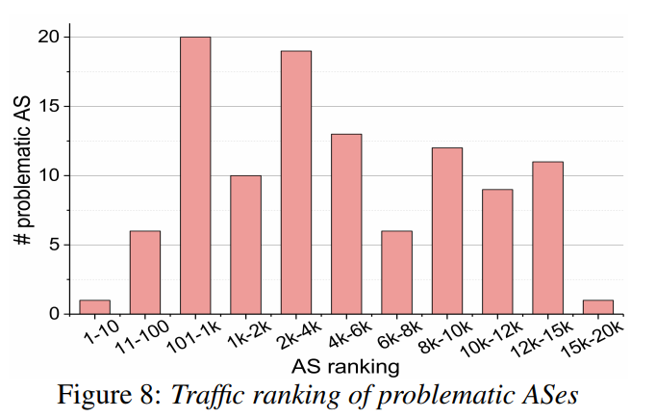
Analysis (Global) : AS-Level Characteristics
Traffic ranking of problematic Ases CAIDA traffic ranking
AS3356 rank 1

Slide 21
Analysis (Global) : AS-Level Characteristics
Country-level analysis: 158 ASes, span 41 countries
Russia 44 ASes (28%), US 15 (9%), Indonesia, Brazil and India
Targeted public DNS services
2 ASes (AS43554 and AS15774) exclusively intercept traffic to Google DNS
Alternative resolvers
locate in the same AS as the clients
Traffic ranking of problematic Ases
interception also exists in reputable ASes

Slide 22
TCP/UDP DNS Interception Analysis (China-wide)

Slide 23
Methodology: Vantage Points
China-wide analysis – Qihoo 360 phone network debugging tool: millions of active mobile users
limit the quantity of our requests to avoid excessive traffic
2 public DNS services, 2 TLDs, 1 protocol — randomly selected, and all 5 RR types (A/AAAA/CNAME/MX/NS)

Slide 24
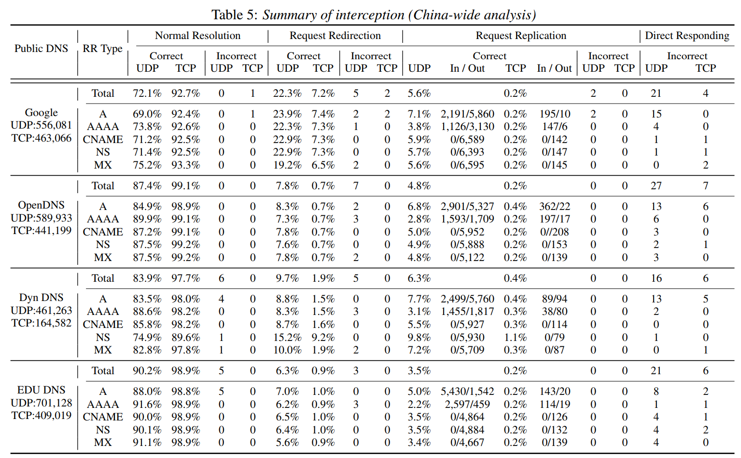
TCP/UDP DNS Interception Analysis (China-wide)

Slide 25
Analysis (China-wide)
Transport protocol: UDP more likely
Targeted public DNS services: renowned significantly higher
DNS RR Types:
A-type slightly preferred
CNAME, NS, MX no in-band response
TLD: no effect

Slide 26
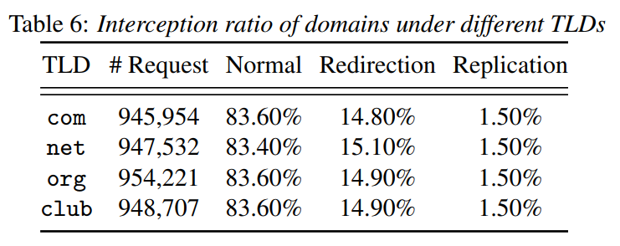
Analysis (China-wide)
TLD: no effect

Slide 27
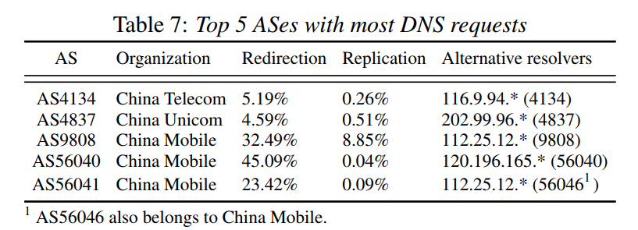
Analysis (China-wide) Case Study
China Mobile significantly higher interception ratio

Slide 28
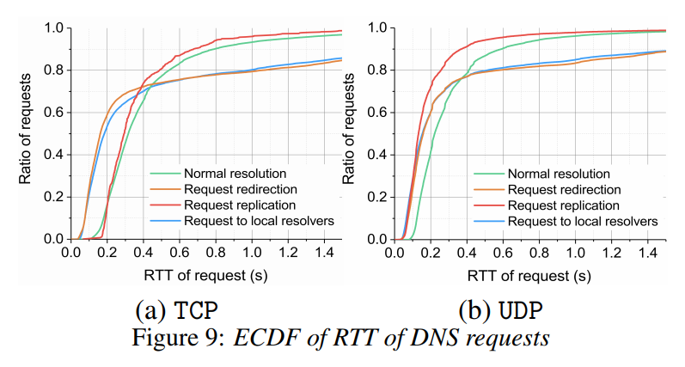
Analysis: Performance of DNS Lookups

Slide 29
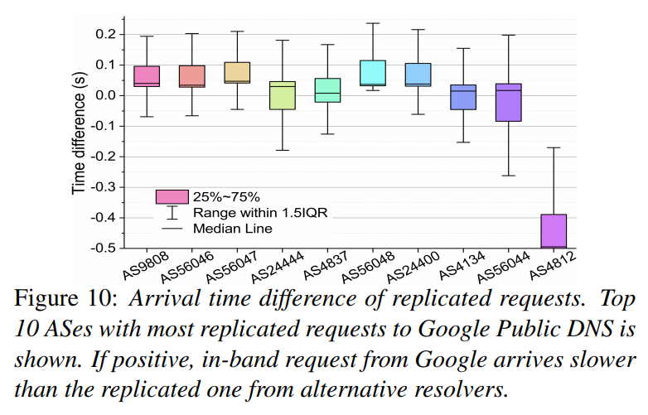
Analysis: Performance of DNS Lookups

Slide 30
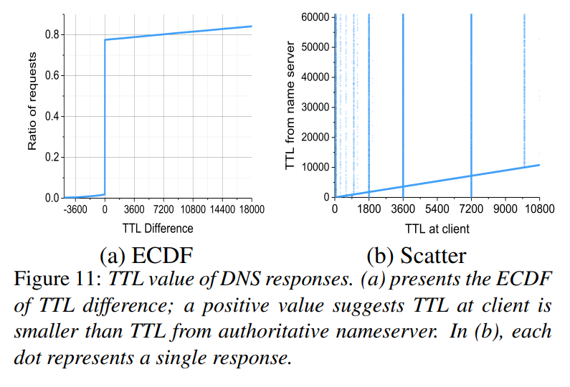
Analysis: Manipulation of Responses
about 20% of the TTL values are replaced, 1800, 3600 and 7200 preferred

Slide 31
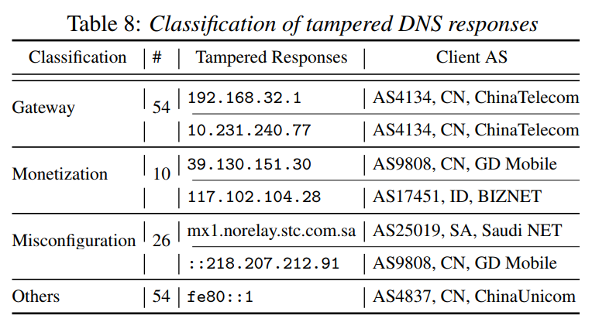
Analysis: Manipulation of Responses

Slide 32
Motivations of Interception
Improving DNS security
Violate trust relationship
Not treated equally
Improving performance of DNS lookups
Request Replication: does shorten
Request Redirection: uncertain, 30% slower than in-band
Reducing financial settlement
Reduce cost of traffic exchange among networks

Slide 33
Threats
Ethics and privacy
possible to illegally monetize from traffic
difficult to detect for users, public DNS resolvers wrong blamed
intercepted DNS requests may be snooped by untrusted third parties
DNS security practices: 205/1166 public
Only 43% accept DNSSEC requests
47% running BIND, all version earlier than 9.4.0 (deprecated before 2009)
DNS functionalities: only 22% accept ECS requests

Slide 34
Mitigation
RFC7858– DNS over TLS
Sophisticated
Need client side changes
What is my dns resolver?
http://whatismydnsresolver.com

Slide 35
Conclusion
A large-scale study on DNS Intercept
Techniques to detect, two unique platforms with numerous vantage points
Release a online checking tool http://whatismydnsresolver.com
Analysis of interception characteristics and motivations

